Slide 1

4(B)
Algorithm
3/22演算法
107501013 許嘉芯
107501572 吳翰驊
107501505王辰淯

Slide 2


給定一個序列S=(-2, -1, -3, -4, -1, -2, -1, -5)，
仿照merge sort的執行過程畫圖說明，
使用分治最大可空連續子序列和演算法，
求出最大可空連續子序列和的過程。
Eaglewood Realty is your guiding hand.

Slide 3
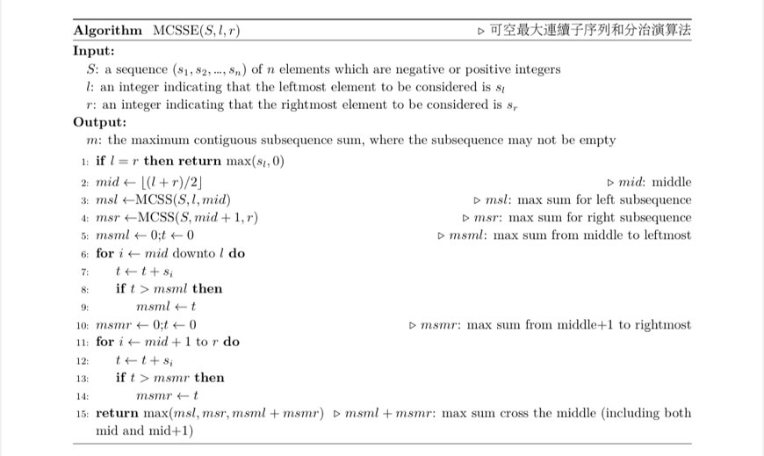
Pseudo
Code
Eaglewood Realty is your guiding hand.

Slide 4
Illustration
What we'll discuss today
[-2, -1, -3, -4, -1, -2, -1, -5]
[-2, -1, -3, -4]
[-1, -2, -1, -5]
[-3, -4]
[-1, -5]
[-2, -1]
[-1, -2]
-1
-5
-2
-1
-4
-3
-1
-2

Slide 5
Illustration
What we'll discuss today
-3
-1
-4
-2
-2 -1
0
-3 -4
0
0
0
0
-2 -1
-3 -4
0
0

Slide 6
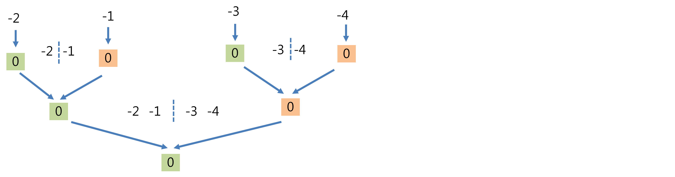
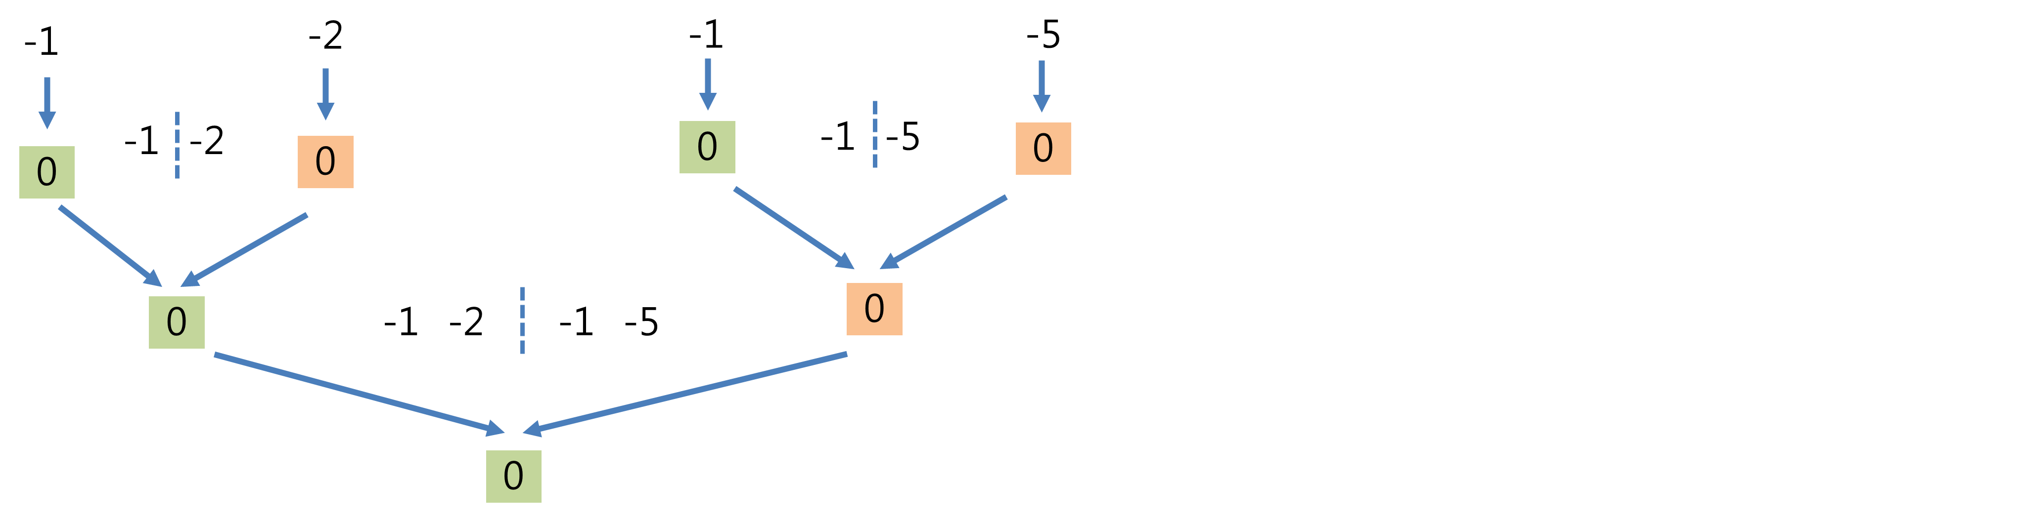

Illustration
What we'll discuss today
-2 -1 -3 -4 -1 -2 -1 -5
0

Slide 7
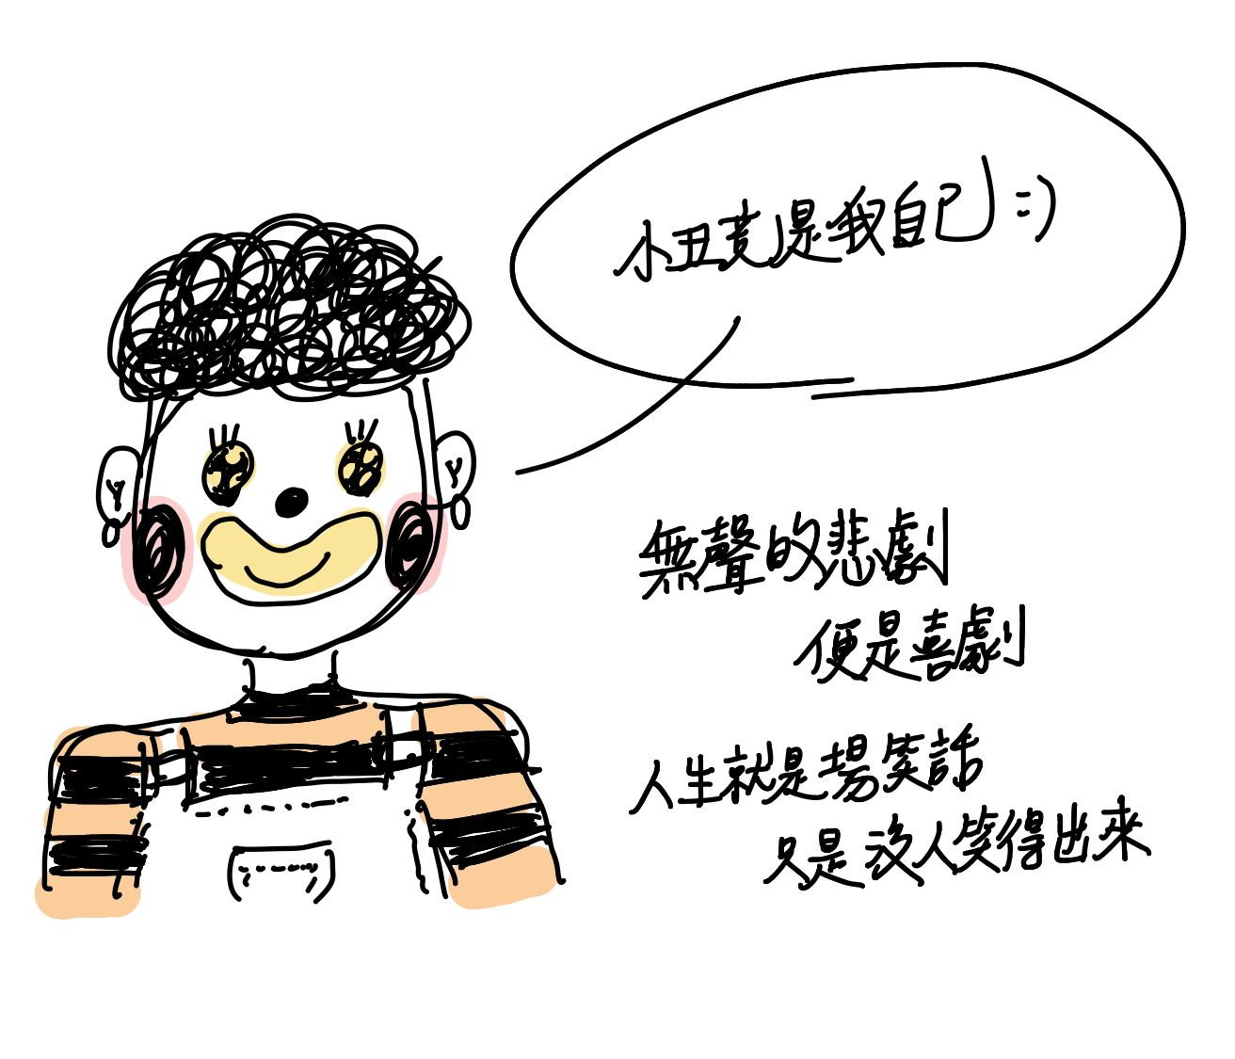
Thank you for your attention ˙3˙

